Slide 1
Is the Airbnb NYC listing price normally distributed? Story Telling
By Muluemebet Ayalew
March ,2020

Slide 2
Outline
Price distribution of the original data
Price distribution for different price range
Empirical cumulative Distribution Function
Distribution after removing outliers above (mean+3*std)
Distribution after log transformation of price
Combining the last two

Slide 3
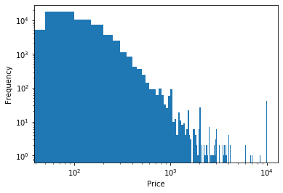
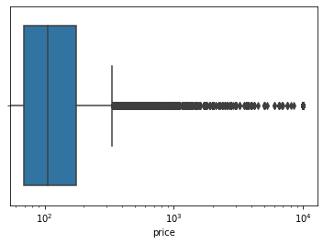
Price distribution of the original data
The distribution is skewed to the right
large data to display

Slide 4
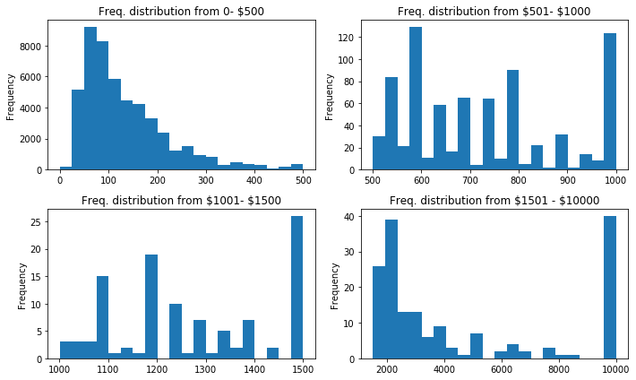
Price distribution for different price range
Better display with smaller data

Slide 5
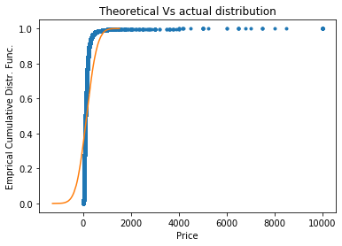
Empirical cumulative Distribution Function
This is how the original data looks

Slide 6
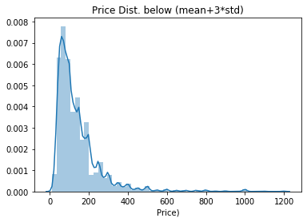
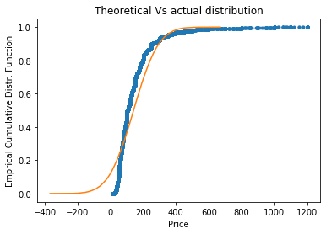
After removing outliers above (mean+3*std)

Slide 7
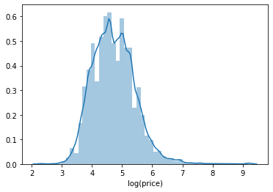
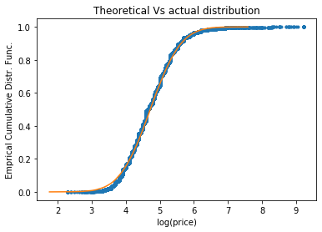
Distribution after log transformation of price

Slide 8
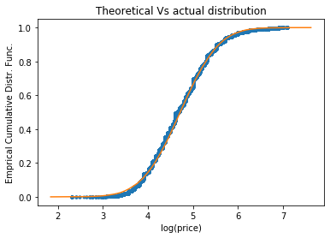
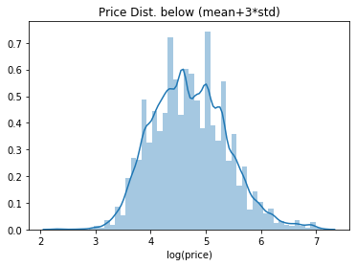
Combining the last two: Prices below (mean+ 3 *std) and log transformed

Slide 9
Conclusion
The original listing price is highly skewed to the right and difficult to assume normal distribution.
After log transformation, it looks normally distributed
Removing outlier and log transformation even make the price distribution looks normal

